Slide 1

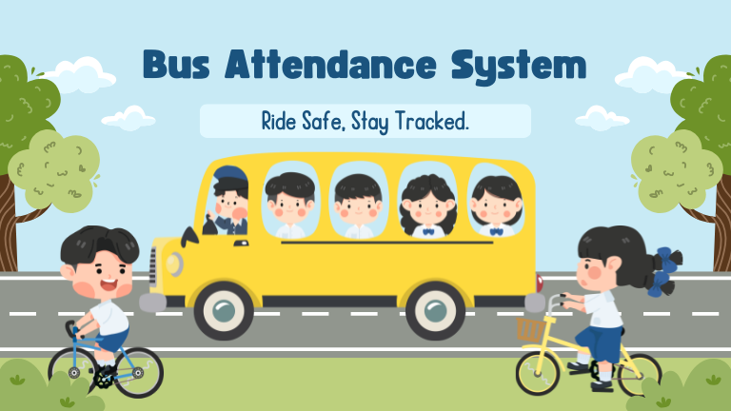
SCHOOL BUS ROUND-TRIP ATTENDANCE SAFETY ALERT SYSTEM
“RIDE SAFE, STAY TRACKED”

Slide 2

1.PROBLEM
Notes:
© Copyright Showeet.com – Free PowerPoint Templates

Slide 3
PROBLEM
Many schools struggle to ensure round-trip safety for students using school buses.
A student who boards in the morning must also return by the same bus.
Missing return-trip boarding can lead to:
  Safety risks
  Panic for parents
  Delayed actions from school authorities
Manual attendance checking is slow and prone to human error.
Need for an automated, real-time alert system that ensures accurate attendance matching.
Notes:
© Copyright Showeet.com – Free PowerPoint Templates

Slide 4
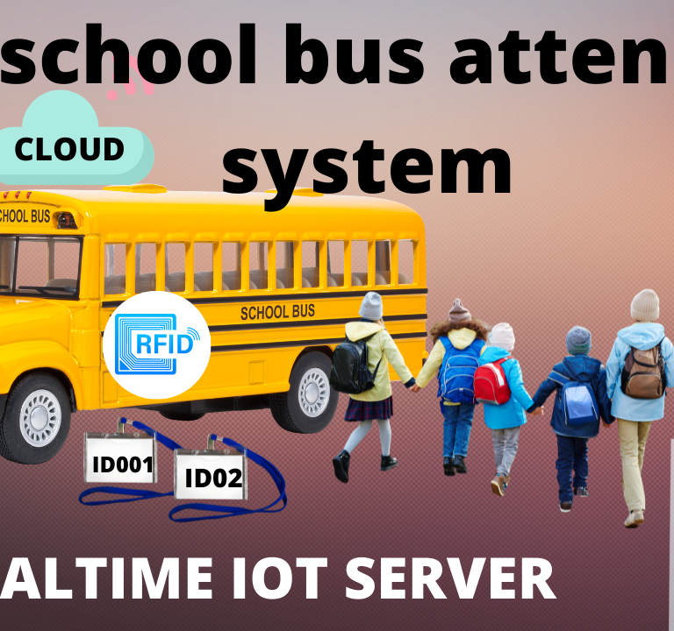
2.DATA

Slide 5
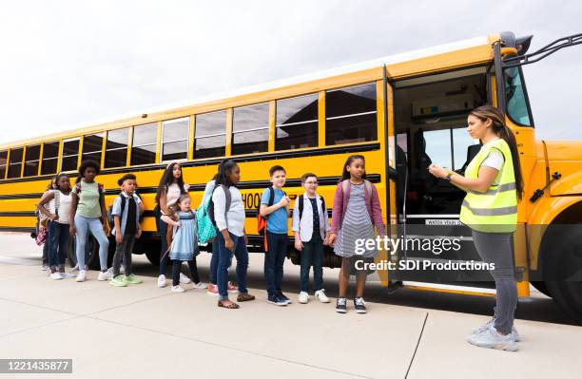
DATA
Student Database
  Student ID, Name, Class, Bus Route, Parent Contact
On-Board Attendance Data
  Morning Boarding Timestamp
  Afternoon Boarding Timestamp
Biometric / Face Recognition Data (if used)
  Facial embeddings
  Confidence scores
Device Data
  Bus GPS location
  Time logs
  Camera/Scanner input
Notes:
© Copyright Showeet.com – Free PowerPoint Templates

Slide 6
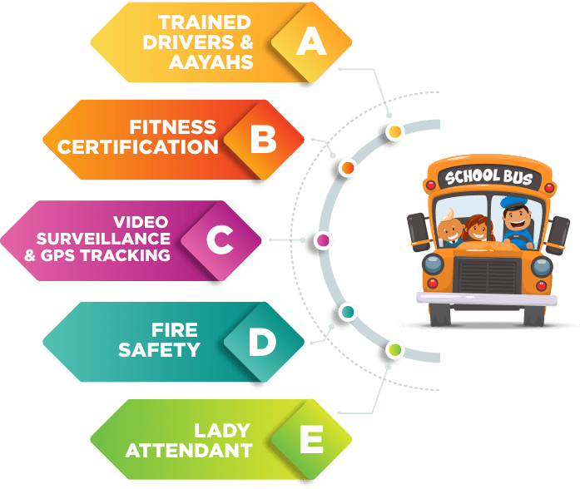
3. MODEL

Slide 7
MODEL
Student Identification Model
  Either Face Recognition or QR-based attendance
  Embeddings created using CNN-based architecture (e.g., MobileNet, FaceNet)
  Thresholding for FAR/FRR optimization
Attendance Matching Algorithm
  Compares morning vs. return trip records
  Flags missing afternoon boarding
Decision Model for Alerts
  If student_boarded_morning AND NOT student_boarded_return
  Trigger alert to parents + school dashboard
Accuracy Metrics Tracked
  Recognition Accuracy
  False Acceptance Rate (FAR)
  False Rejection Rate (FRR)
  Alert Accuracy & Latency

Slide 8
4.RESULT

Slide 9
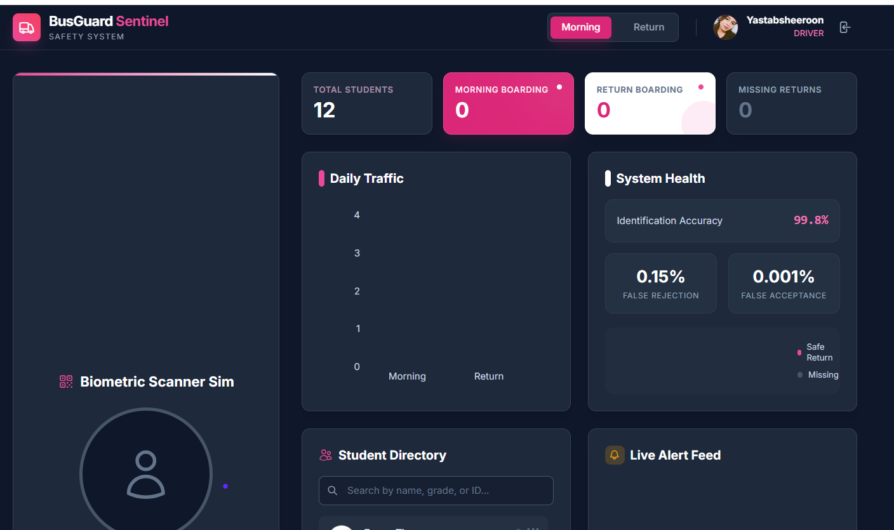
RESULT
Up to 95–98% accuracy in student recognition using optimized thresholds.
Zero-delay automated alerts initiated within 10–20 seconds of missed boarding.
Dashboard view shows:
Total students boarded
Students missing
Alerts triggered
Reduction in manual labor by 70%.
Parents report high trust due to timely notifications.

Slide 10

5.INSIGHTS & RECOMMENDATIONS

Slide 11
INSIGHTS &RECOMMENDATIONS
Insights
Peak crowd times reduce recognition accuracy.
Younger students have higher missed boarding incidents.
Masked faces or low lighting affect face recognition performance.
Alerts significantly improve parent–school communication.
Recommendations
Implement a hybrid attendance system (Face + QR) for better accuracy.
Use edge devices for faster real-time processing on buses.
Add GPS tracking integration with the attendance dashboard.
Conduct regular accuracy checks to reduce FAR/FRR.

Slide 12

Large Image slide
Notes:
© Copyright Showeet.com – Free PowerPoint Templates

